Slide 1

Corrective Action and Discipline
Presented by:
Human Resource Services
Revised Oct. 2014

Slide 2

Objectives
Overview of Corrective
Action Process
Overview of Discipline
Process
When these processes
should be pursued

Slide 3
Is there a need for CORRECTIVE ACTION in the workplace? Why or Why not?
What is the difference between CORRECTIVE ACTION
and
DISCIPLINARY ACTION?

Slide 4
Corrective Actions Are . . .
Preventative measures taken
  to promote compliance with established agency rules and expectations;
  to change unacceptable behavior.

Slide 5
Benefits of Corrective Action
Communication
Provides Opportunity to Adjust
Accountability
Standardizes Process

Slide 6
Disciplinary Actions are . . .
Formal, pay affecting actions, taken when either
  corrective measures fail to correct problem OR
  seriousness of offense warrants more formal measures
Imposed only by appointing authority
(per BPPM 60.10. See HRS webpage to find out who the AA for your area is)

Slide 7
Progressive
Typically, both corrective and disciplinary actions are “progressive” -- starting at the lowest level, and then progressing up the steps.
However, this depends on the specifics of each case

Slide 8
Progression of Corrective Action
Letter of Reprimand
Performance Improvement Plan
Notice of Counseling
Verbal Counseling w/summary of meeting
Verbal Counseling

Slide 9
Addressing Performance Issues
Meet with employee in person
Consider setting/location
State concerns/issues clearly
Focus on behavior, not person
Indicate seriousness of problem
Clarify expectations

Slide 10
Clear Rules & Guidelines
Are more effective when they are:
  Needed
  Communicated
  Understood
  Written/Recorded
  Applied equally
  Enforced

Slide 11
Department Expectations
Typical examples of department expectations:
        Hours of work
        Overtime rules
        Dress Code
        Requesting annual leave
        Call-in procedures for sick leave

Slide 12
Identifying a Performance Deficiency
Review the following:
Position description, goals and expectations
  Current and accurate?
Last Performance Reviews or Annual Review
BU employees do not have
Applicable policies/procedures both university and departmental:
  How was it communicated to staff?

Slide 13
Examples
Your employee Jane Doe Smith is the receptionist for the department. Her work schedule is 8 am to 5 pm. For the last month she arrives to work around 8:15 am.
How would you address the situation?

Slide 14
Examples
Your employee Jane Doe Smith continues to be late to work. She is now taking longer breaks and extending her lunch period.
How would you handle this situation?

Slide 15
The Wrong Way to Document…
On June 5, met with Joe Adams, verbally counseled about improper behavior.
As written – will you remember the “behavior”?

Slide 16
The Right way…
On June 5, Joe Adams was verbally warned about his inability to meet deadlines and failure to come into work at his designated start time(s) on dates(s).

Slide 17
Another Wrong Way …
Joe Adams is unable to do his job.
How would you correct this note?

Slide 18
The Right Way…
Joe Adams did not complete xyz project by the established deadline of date and has been late to work by more then 15 minutes on date, date and date.

Slide 19
Examples
Employee John Smith has been absent on a regular basis and late for work without calling in to you.
  Last month you issued him a Notice of Counseling for similar behavior.
  How would you handle this situation?

Slide 20
During a Corrective Action Meeting
Let the employee respond
  Listen
  Don’t Interrupt
  Don’t lose your temper
  Don’t argue
Consider/Reconsider course of action based on employee input

Slide 21
Progression of Disciplinary Action
(Appointing Authority)
Dismissal
Demotion
Reduction in Pay
Suspension (1-15 days)
Pre-Disciplinary Notice

Slide 22
Tips
Apply discipline consistently, fairly and impartially
Set a good example
Don’t “save up” concerns
Treat every case as if it will be appealed
Praise in public—criticize in private
Contact HRS for guidance

Slide 23
Things to be Aware of…
Notice of Investigation
Timeliness
Double Discipline
Due Process
Union Contract

Slide 24
Notice of Investigation
Depending on the issue/situation a Notice of Investigation (NOI) may be appropriate to give.
Bargaining unit covered employees must receive a written NOI within 10 working days from the date the supervisor or manager becomes aware of the situation.

Slide 25
More…
Samples of Investigations:
Allegations of inappropriate use of state resources
Allegation of workplace violence
Office for Equal Opportunity (OEO): Allegation of harassment or discrimination

Slide 26
Double Discipline
Cannot discipline for conduct which was previously addressed as corrective action (verbal or written).

Slide 27
Considering Disciplinary Action
Contact HRS for guidance
Issue a Pre-Disciplinary Notice
Schedule a Pre-Disciplinary Meeting
Appointing Authority should attend meeting
HRS attends the meeting

Slide 28
Examples
Employee John Smith over the past month has been consistently late for work and on two separate occasions was
a no-call no-show.
How would you handle this situation?

Slide 29
Pre-Disciplinary Meeting
This is the Employee’s meeting
Employee is allowed to have a union representative or co-worker attend
Meeting is voluntary, employee can respond in writing or not attend
After the meeting, the Appointing Authority makes decision, taking into consideration employee’s input

Slide 30
Considerations
Does the proposed discipline fit the violation?
Is the proposed discipline likely to correct behavior?
Review prior performance issues
Review performance evaluations
Extenuating circumstances
Seriousness of the offense

Slide 31
Disciplinary Action Letter
Action is decided AFTER employee has had the opportunity to respond
If disciplinary action is decided, the appointing authority notifies employee in writing of action.
HRS drafts the letters.

Slide 32
How Would You Handle…
Your employee walks off the job without permission:
  The employee requests use of annual leave the next day to cover time missed.
  Should you approve use of annual leave?

Slide 33
More…
You send your employee home due to inappropriate behavior:
  Are you required to pay the employee?

Slide 34
More…
You gave your employee a pre-disciplinary notice.
  Employee calls in sick the next day, completes Family Medical Leave (FML) paperwork and is approved.
  What happens to the pre-disciplinary process?

Slide 35
Memo & Letter Templates
HR Consultants are available to provide guidance with employee issues including verbal counseling, and writing corrective action memos or letters.
HRS and the appointing authority draft disciplinary action letters.
Web resources are also available in the Managers Section at www.hrs.wsu.edu

Slide 36
Probationary & Trial Service
Probationary Employees
  Performance concerns
      Previously discussed – behavior continues
  Requires 1 day written notice (WAC 357-46)
  Template of notification letter on HRS website
Trial Service Employees
  Recommended that employee is notified of deficiency AND allowed a reasonable amount of time for improvement before reversion
  Requires 7 calendar days written notice for civil service, 15 calendar days for BU

Slide 37
Question…
What are the possible implications of an employee not performing at highest standards passing a probationary or trial service period?

Slide 38
Employee Assistance Program
Referrals to EAP may be appropriate
  If you are experiencing personal problems which may be impacting your ability to effectively perform the duties of your position, I encourage you to contact the Employee Assistance Program at Washington Building G60 or phone 335-5759.

Slide 39
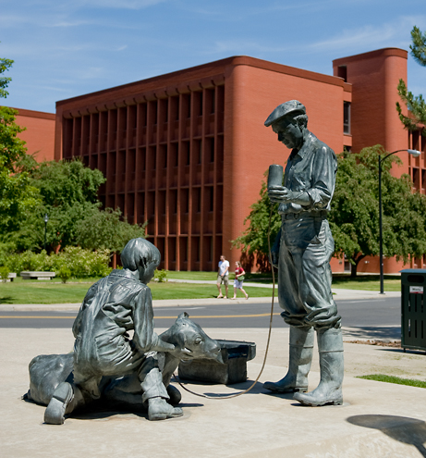
Resources
WAC 357-37, 38
Collective Bargaining Unit Agreements
HRS Website –
hrs.wsu.edu
  Corrective/Discipline Guide
  For assistance and answers to questions contact HRS at 335-4521, or hrs@wsu.edu

Slide 40
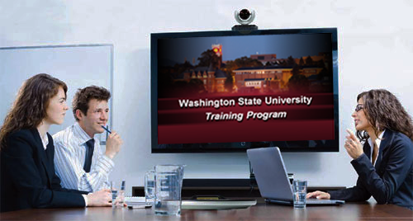
This has been a WSU Training Videoconference
If you attended this live training session and wish to have your attendance documented in your training history,
please notify Human Resource Services
within 24 hours of today's date:
hrstraining@wsu.edu

